Slide 1
Fortemedia FM1505 Module Board test
Test by Nessie Jack Hu

Slide 2
Test Items and Environment settings
Beamforming In-Beam / Out-Beam function
AI Noise Suppressor function

Slide 3
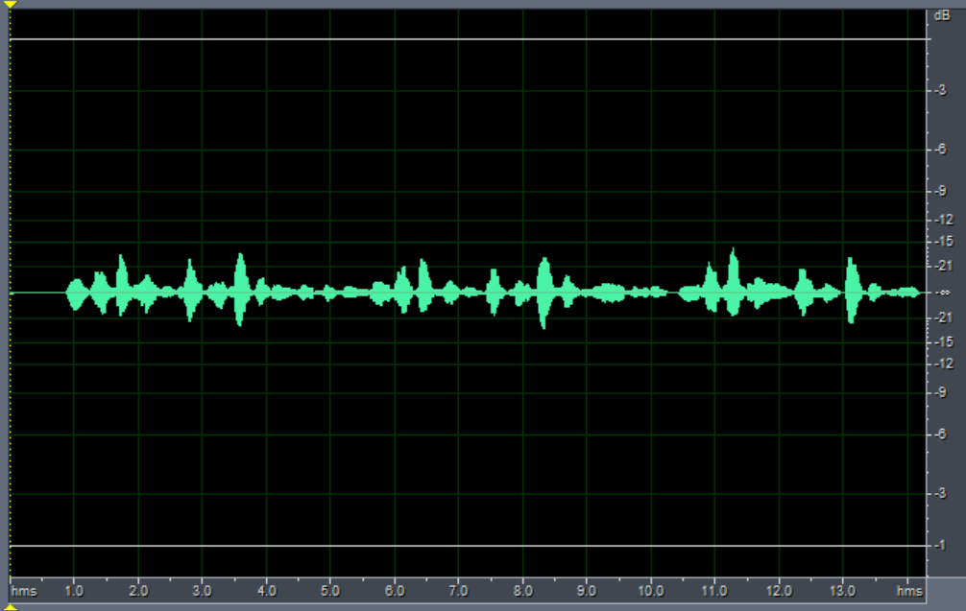
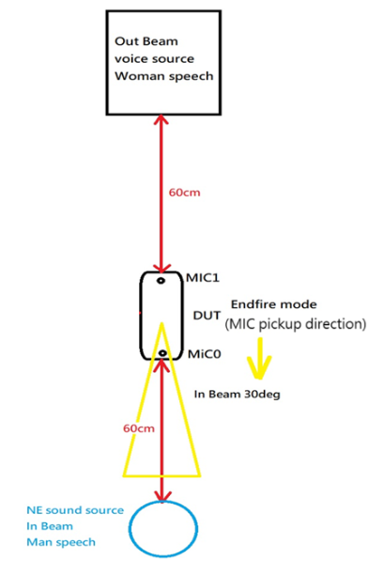

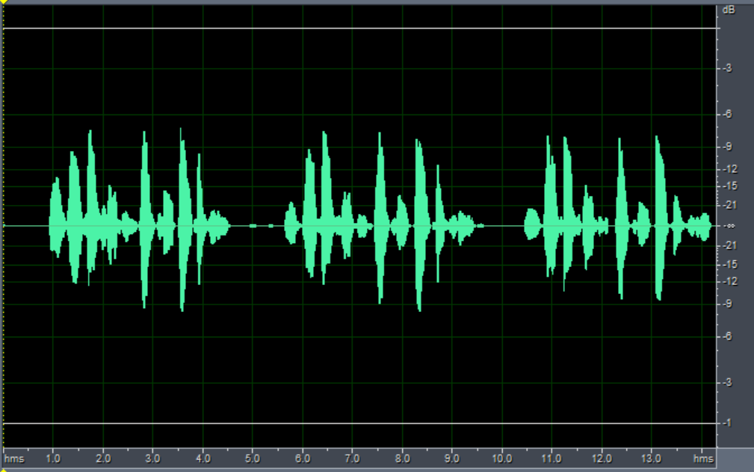

FM1505 Beamforming test
FM1505 Beamforming MIC0(Before processing)
)
Test Environment
FM1505 Beamforming LOUT(After processing)
)

Slide 4
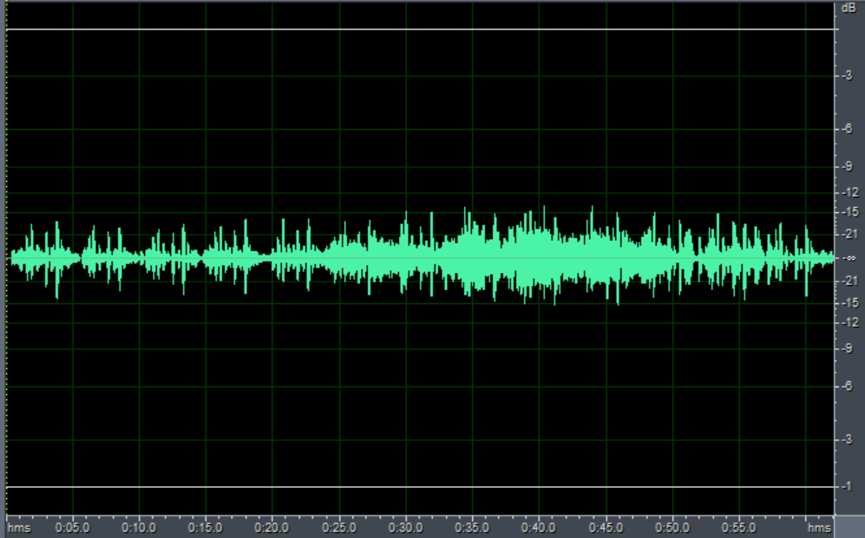
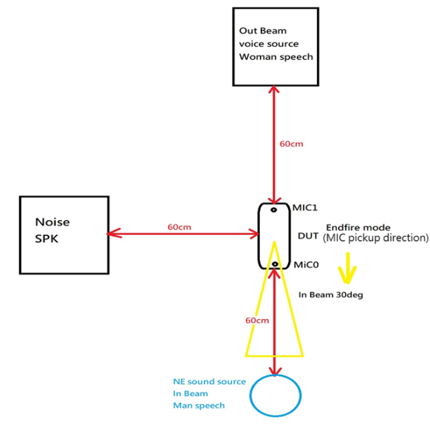
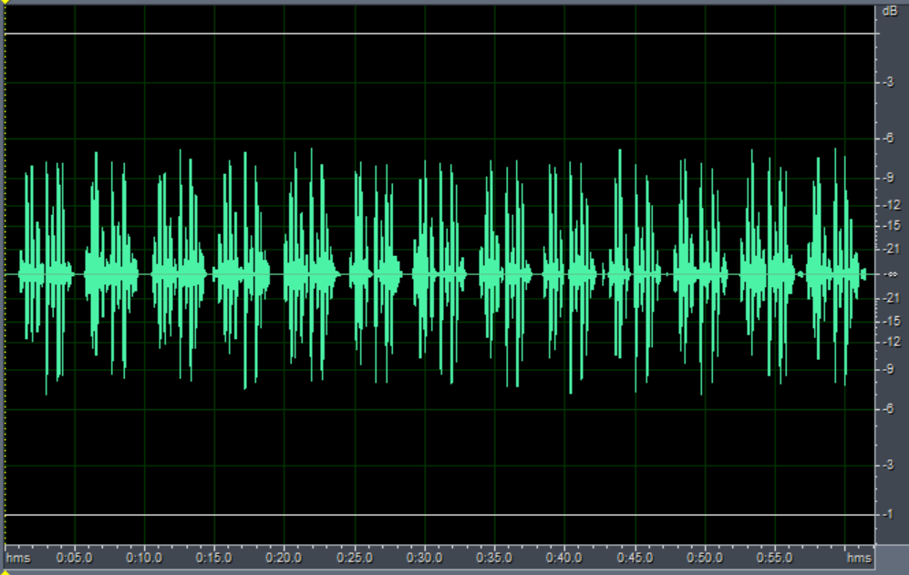
FM1505 Beamforming and AI NS Test
FM1505 Beamforming and AI NS MIC0(Before processing)
Test Environment
FM1505 Beamforming and AI NS LOUT(After processing)

